Slide 1
Demonstration of types of viruses and its mechanism
- TECHSTART STARTUP INNOVATION ROUND -

Slide 2
TABLE OF CONTENTS
Members & assignment
General class diagram
Problem statement
Use case diagram
Explanation of OOP techniques
Use case diagram

Slide 3
Members & assignment
Phan Duc Quyen 20225916 (Leader)
Duong Duc Duy 20225828
Nguyen Duc Manh 20235476

Slide 4



Problem statement
In the realm of virology, understanding the structure and infection mechanisms of various viruses is crucial. However, the complexity of these microscopic entities often makes it challenging for students and researchers to grasp these concepts.
Providing an interactive platform where users can choose from various types of viruses for focused study.
View the detailed structure of a specific virus to understand its composition
Examine the detailed infection mechanism to learn how it operates.
Notes:
In the realm of virology, understanding the structure and infection mechanisms of various viruses is crucial. However, the complexity of these microscopic entities often makes it challenging for students and researchers to grasp these concepts. Traditional learning resources may not provide an interactive and engaging way to study these viruses.
Our project aims to address this issue by providing an interactive platform where users can choose from various types of viruses for focused study. They can view the detailed structure of a specific virus to understand its composition and examine the detailed infection mechanism to learn how it operates. The platform also provides text and video explanations for a comprehensive learning experience.

Slide 5
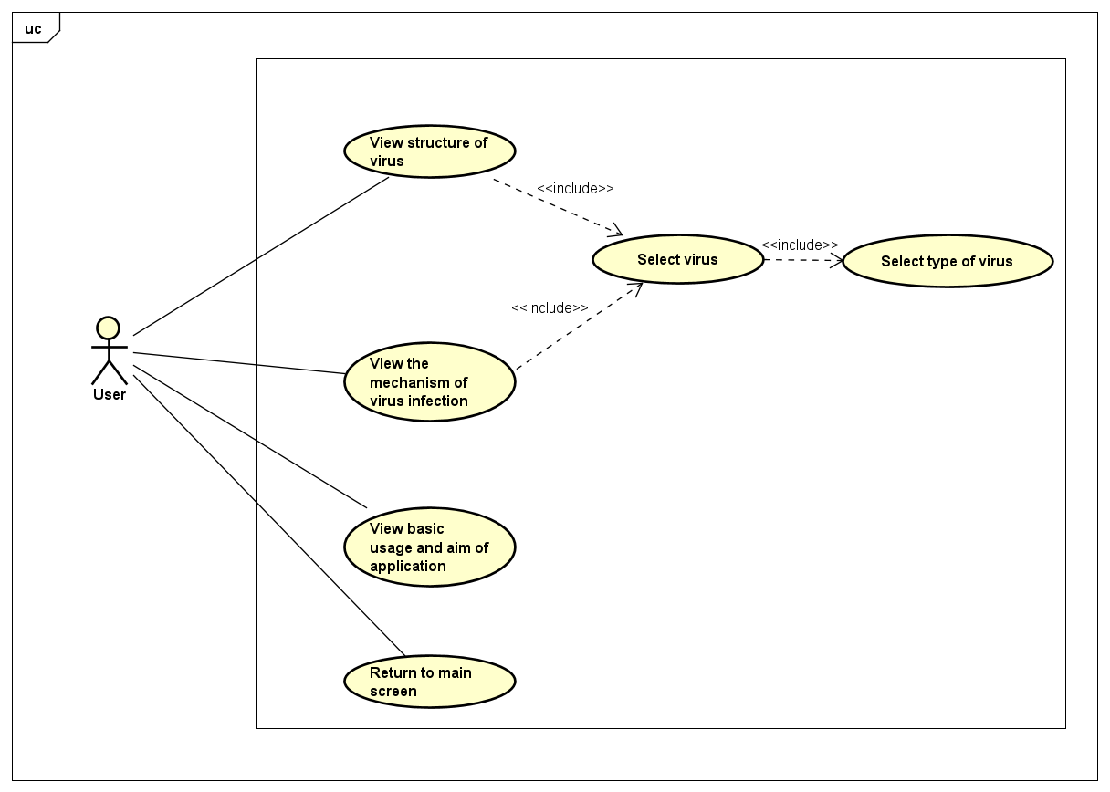
Use case diagram

Slide 6
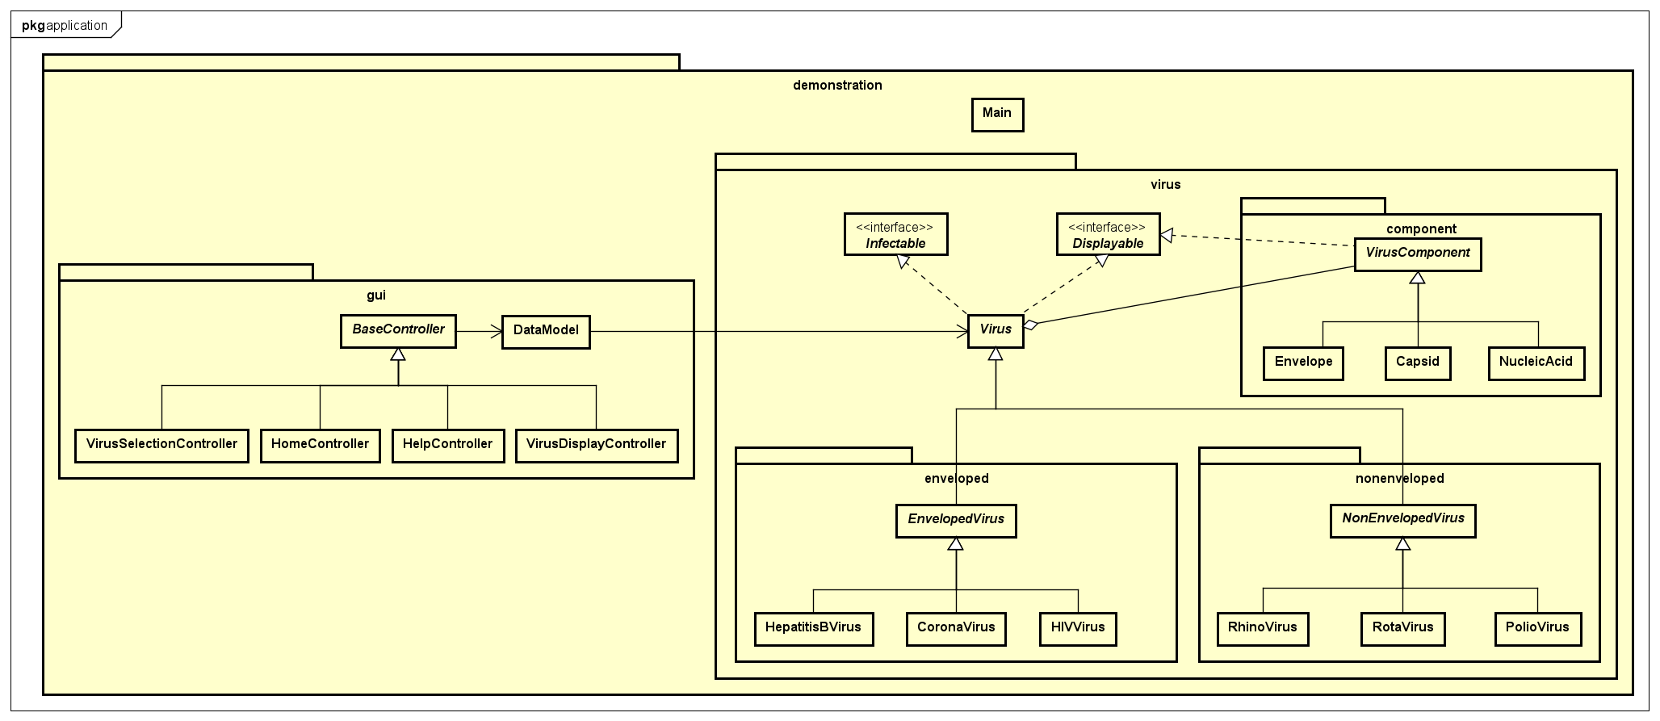

General class diagram

Slide 7

OOP techniques
Encapsulation
Attributes of class are set to private
Use Getter and Setter to access, modify the attributes
=> Remain Integrity of the data

Slide 8
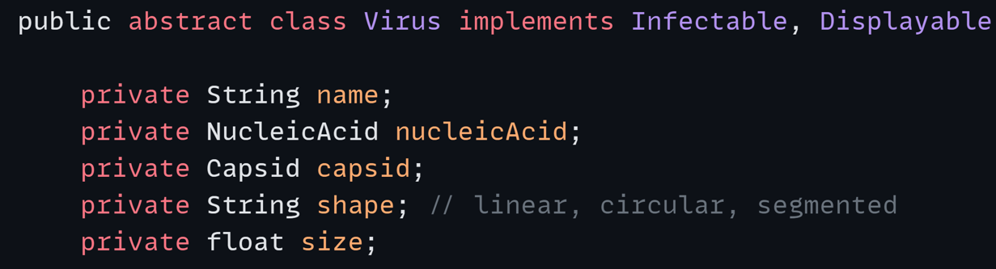


OOP techniques
Composition
Notes:
A method that can perform different tasks based on the object that it is acting. This is closely related to the concept of inheritance.

Slide 9
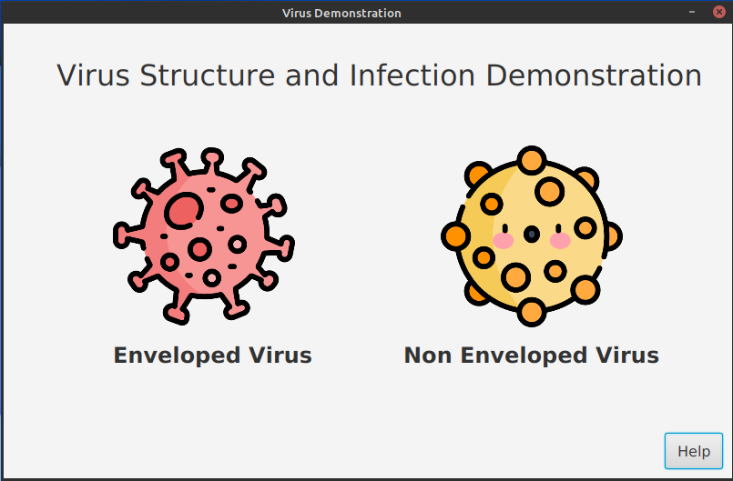
Demo

Slide 10
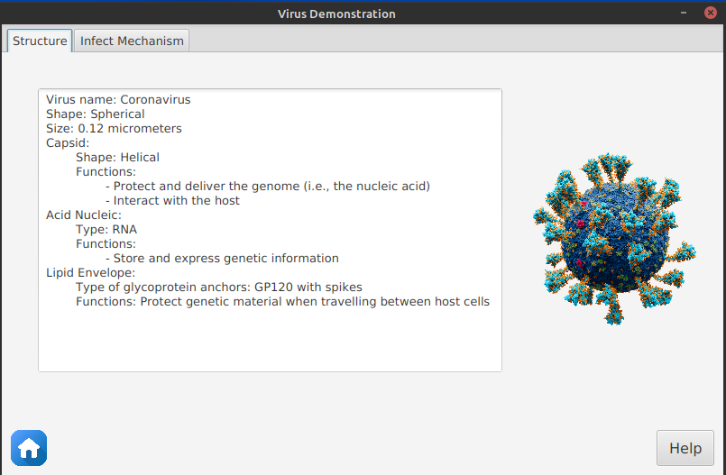
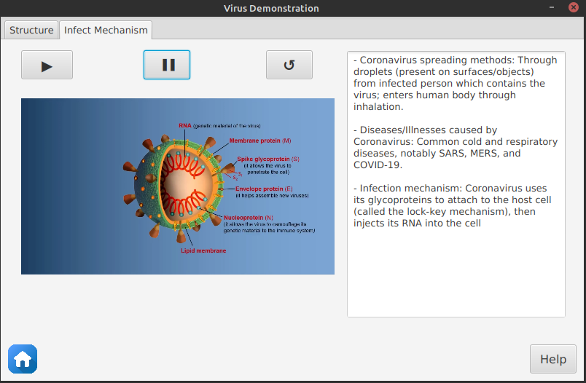
Demo

Slide 11
